Slide 1
Caption Types & Captain of Captions Game

Slide 2
Learn
Students will learn three types of captions: indent, summary and expanded.

Slide 3
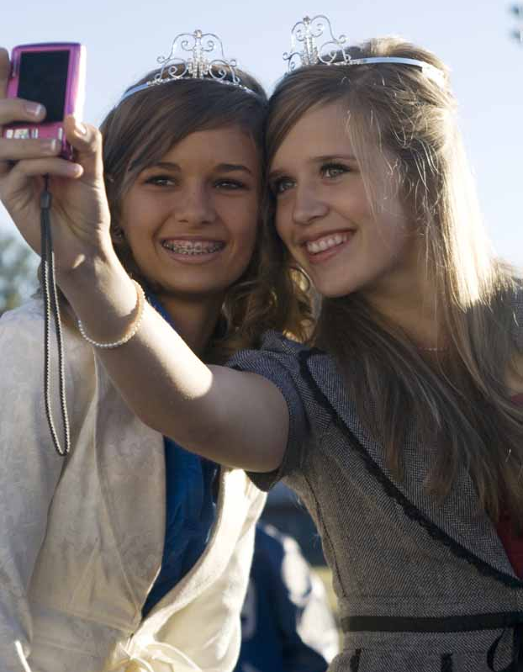
Indent Captions Brief Identification Of Subjects
Seniors Maria Gonzales
and Jennifer Williams
or
ROYAL CLICKS
Seniors Maria Gonzales
and Jennifer Williams
or
‘MAID’ PERFECT
Seniors Maria Gonzales
and Jennifer Williams
Best friends and homecoming maids

Slide 4
Summary Captions Answer the most important 5Ws and H
TICKLED PINK
After having just been named senior homecoming maids, Maria Gonzales and Jennifer Williams pose for themselves at the pep rally and send a quick picture to their family and friends before posting on their Facebook pages.

Slide 5
Expanded Captions Summary caption plus more information, insight
PICTURE PERFECT
After having just been named senior homecoming maids, Maria Gonzales and Jennifer Williams, best friends since kindergarten, pose for themselves at the pep rally and send a quick picture to their family and friends before posting on their Facebook pages. “I was thrilled when Maria was named one of the maids, and I never even heard them announce my name,” Williams said. “Then Maria screamed and pointed at me. We took our pic together to send to our grandparents and post on Facebook.”

Slide 6
Practice
Students will play the Captain of Captions Game to practice identifying caption types.

Slide 7
Rules
Divide students into two teams.
In the following slides, students will see sample captions. Each caption will be read.
One representative from each team will step up to an imaginary buzzer.
The first student to hit their imaginary buzzer and correctly identify the type of caption becomes a Captain of Captions.
Rotate through the students on each team, with one from each team competing each round.
The team with the highest number of Captains of Captions wins the game.

Slide 8
Captain of Captions
Seniors John Smith & Betty Carls
Notes:
Answer: Ident Caption

Slide 9
Captain of Captions
After months of planning, Junior Allan Tody and Senior Sonja Jones, co-founders of the student group Kids Against Hunger, kick off the first annual Hunger Bash. The Bash included a dance and the opportunity to donate canned goods to the WeCAN food shelf. “It was something we have always wanted,” Jones said. “We’re glad to finally make our dream a reality.”
Notes:
Answer: Expanded Captions

Slide 10
Captain of Captions
Freshman Ariana Studanski.
Notes:
Answer: Ident Caption

Slide 11
Captain of Captions
Sophomore Phoebe Weber and Adrian Summers.
Notes:
Answer: Ident Caption

Slide 12
Captain of Captions
Best friends since third grade, Sophomores Phoebe Weber and Adrian Summers welcome new students at Orientation Night and share how they first met at Blake High School.
Notes:
Answer: Summary Captions

Slide 13
Captain of Captions
After having a great final season, Senior John Smith plans to continue teaching tennis at the area Boy’s and Girl’s Club in order to not only keep up with the sport, but to also share his passion for it with others.
Notes:
Answer: Summary Captions

Slide 14
Captain of Captions
Winning his third consecutive National Association of Teachers of Singing contest, senior Brian Andrews performs live for students in his music class. Andrew has been taking private voice lessons since he was six years old. “Music has always been something I’ve enjoyed,” Andrews said, “and I can see myself continuing to utilize this gift for the rest of my life.”
Notes:
Answer: Expanded Captions

Slide 15
Captain of Captions
Freshman Johnnie Rodes stands next to his rock collection that he started when he was seven. “Rocks have always interested me. My parents brought me to Yellowstone National Park when I was 15 to study the geology of the volcanic region; it was so cool.”
Notes:
Answer: Expanded Captions

Slide 16
Captain of Captions
Heading to her next class, Sophomore Rachel Erickson stops to take a selfie with Junior Erica Larson next to the school’s mascot.
Notes:
Answer: Summary Captions

Slide 17
Captain of Captions
Junior Ralph Edwards
Notes:
Answer: Ident Caption

Slide 18
Captain of Captions
After attending the homecoming dance, senior Richard Thompson and junior Alissa Evans gather as many people as they can to reenact the Grammy selfie in front of the balcony of the cafeteria. Just six months before, Actress Ellen DeGeneres made the group selfie famous. “We couldn’t resist the moment,” Evans said. “We had to Instagram this night so that we could remember it forever.”
Notes:
Answer: Expanded Caption

Slide 19
Captain of Captions
Eighth graders Carl Lundburg, Chase Foreseth and Samantha Prince.
Notes:
Answer: Ident Caption

Slide 20
Captain of Captions
Enjoying the last few minutes of the field trip to the world’s best water park, Junior Alanna Roelofs takes one last lap around the pool.
Notes:
Answer: Summary Caption

Slide 21
Captain of Captions
Walking somberly in the hallways singing Amazing Grace, the students of Mr. Rosenberg’s Science class have a ceremony for the dissected animals they worked on all semester. The science unit included both anatomy and the ethical treatment of animals. “We wanted to give them a proper burial,” senior Ross Harth said, “and we figured everyone in the school should be part of it.”
Notes:
Answer: Expanded Caption

Slide 22
Captain of Captions
Freshmen Suzie Young and Veronica Eggen.
Notes:
Answer: Ident Caption

Slide 23
Use
Look at the photos on the yearbook pages you are creating. Determine whether the correct type of caption has been used and write/edit accordingly.

